Slide 1
COMP90007 Internet Technologies Lab – Network Analysis
Week 4

Slide 2
Slides
https://github.com/SiaHuo/COMP90007Workshops
If there is any error in slides, please point it out.
Please refer to solution on LMS for standard answers

Slide 3
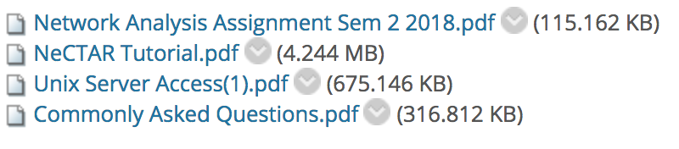
Go to LMS – Assignment - Network Analysis Assignment
It is recommended that you perform these tasks in a consistent networking environment to reduce the variance in your results

Slide 4
Go to LMS – Assignment - Network Analysis Assignment
It is recommended that you perform these tasks in a consistent networking environment to reduce the variance in your results

Slide 5
Experiment 1 -- Measuring the hop count
traceroute/tracert(packet)
Represent the hop number from the source to the target
Mac User: Open Terminal
traceroute –nw 1 cis.unimelb.edu.au
Windows User: Open Command Prompt
tracert cis.unimelb.edu.au
Computer network diagnostic tool for displaying the route and measuring transit delays of packets across an Internet Protocol (IP)

Slide 6
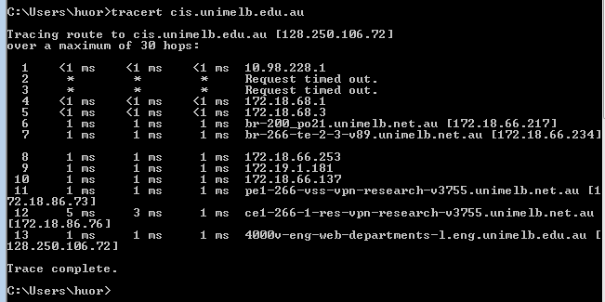
Mac User: Open Terminal
traceroute –nw 1 cis.unimelb.edu.au
Windows User: Open Command Prompt
tracert cis.unimelb.edu.au
traceoute –P icmp cis.unimelb.edu.au
**** time out hops still count

Slide 7
Mac User: Open Terminal
traceroute –nw 1 cis.unimelb.edu.au
Windows User: Open Command Prompt
tracert cis.unimelb.edu.au
traceoute –P icmp cis.unimelb.edu.au
**** time out hops still count

Slide 8
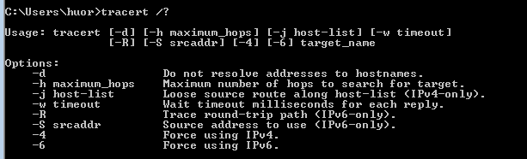
Parameters
Mac User: man traceroute
Windows User: tracert /?

Slide 9
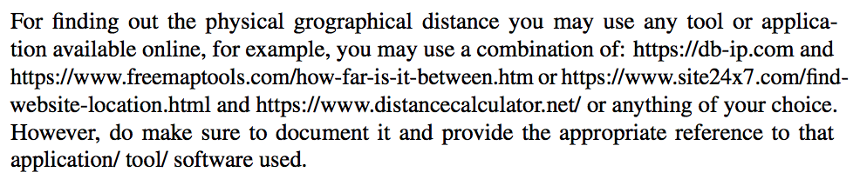
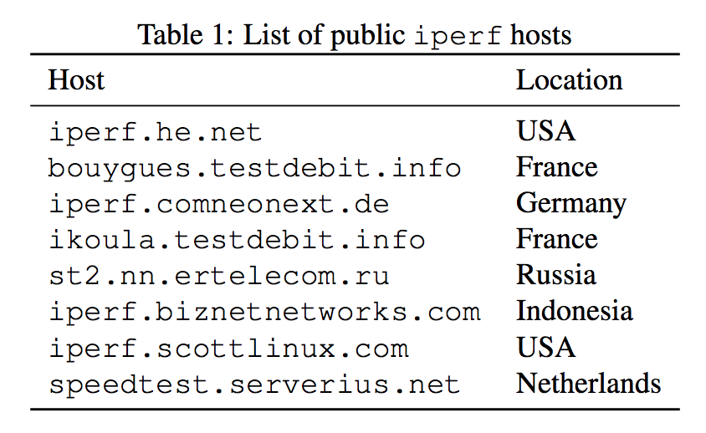
Task 1
Plot the hop count versus the approximate geographical distance from Melbourne. Do you observe a correlation? Why? Why not?

Slide 10
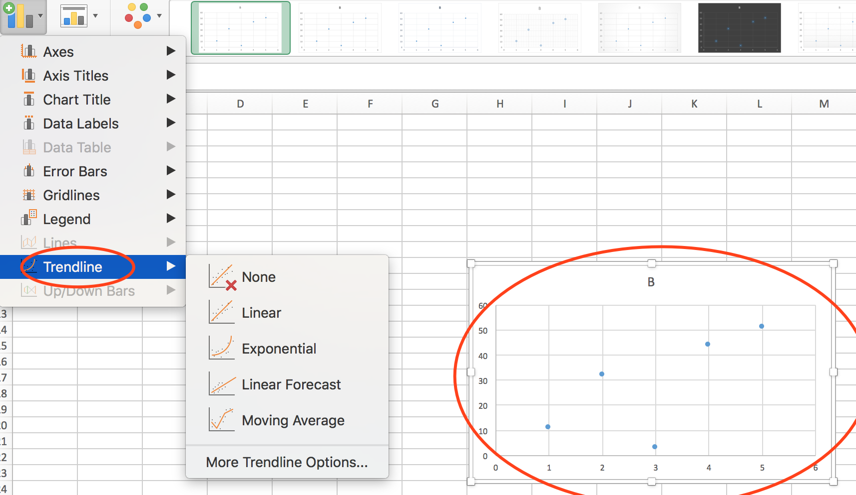
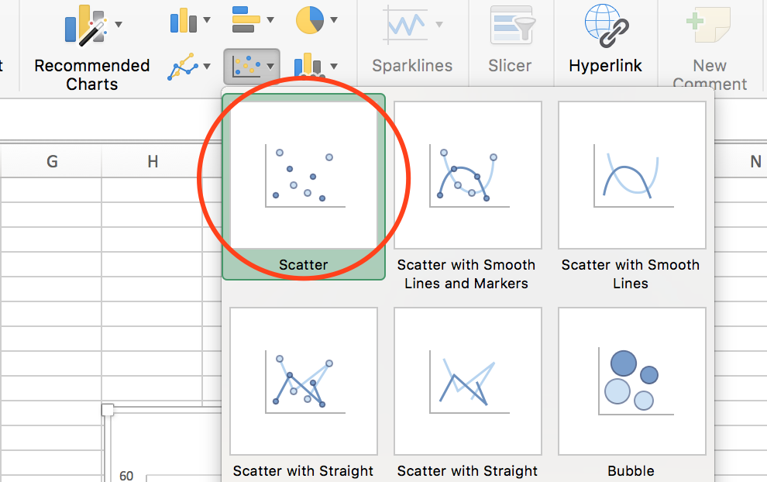
Task 1
Plot the hop count versus the approximate geographical distance from Melbourne. Do you observe a correlation? Why? Why not?
Scatter plot

Slide 11
Experiment 2 Measuring delay and jitter
ping
Windows User: ping cis.unimelb.edu.au
Mac User: ping –c 5 cis.unimelb.edu.au

Slide 12
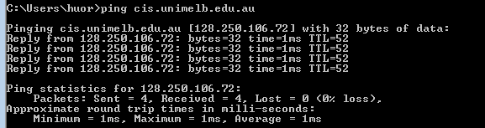
Windows User: ping cis.unimelb.edu.au
Mac User: ping –c 5 cis.unimelb.edu.au
Round-trip time (RTT): is the length of time it takes for a single to be sent plus the length of time it takes for an acknowledgement of that signal to be received.

Slide 13
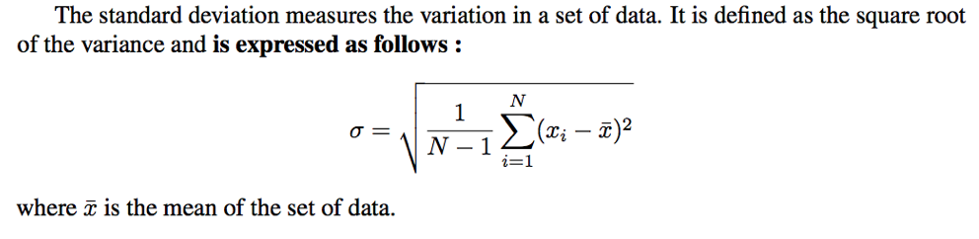
Jitter
How to calculate jitter?
The standard deviation of the round-trip delay time will be taken as the value for jitter for this project

Slide 14
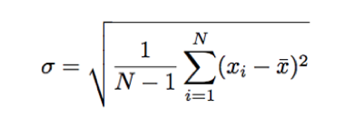
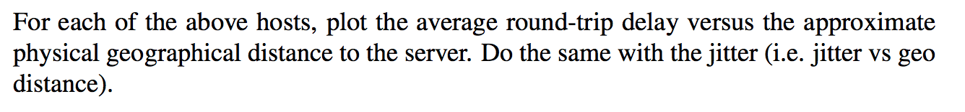
Task 2
Run the ping command 3 times of each host, and find the average round-trip delay and jitter by calculating the standard deviation, for each host in Table1

Slide 15
Experiment 3 Bandwidth
iperf
Download to your own laptop
Use university servers: digitalis, digitalis2
Server mode –s / Client mode –c
Server mode: iperf3 –s
Client mode: iperf3 -c iperf.eenet.ee
An iperf instance running in client mode will connect to the server, and packets will be exchanged and timed between the two hosts to calculate the bandwidth

Slide 16
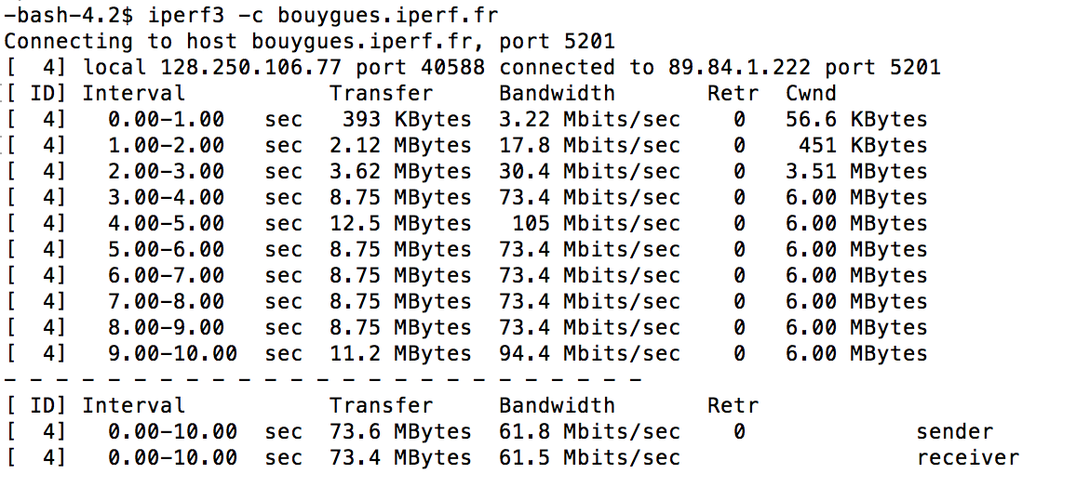
iperf3 –c bouygues.iperf.fr

Slide 17
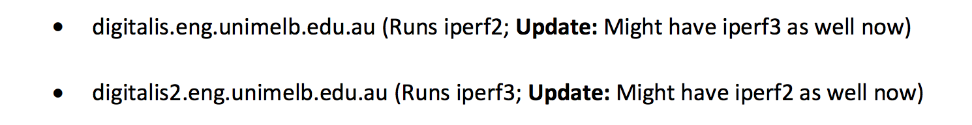
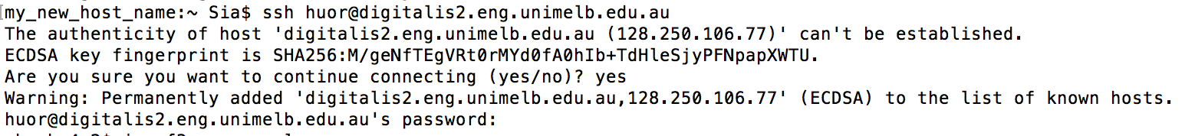
How to access to unimelb server: deigitalis, digitalis2
(refer to the document on LMS)
Mac user: ssh username@digitalis2.eng.unimelb.edu.au
Windows user: PuTTy
Download a software called PuTTY, http://www.putty.org/

Slide 18
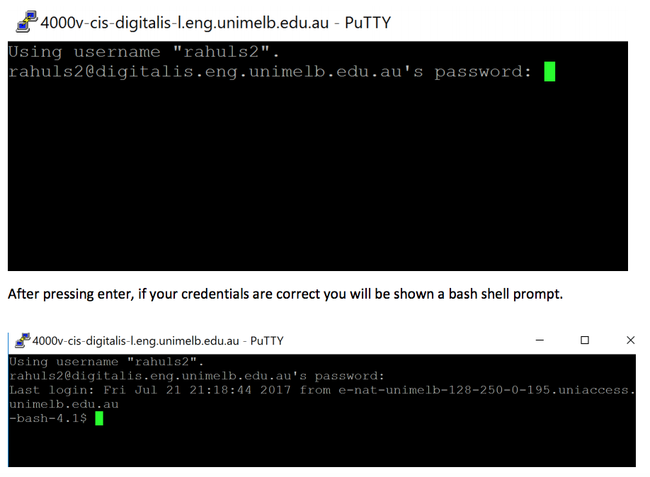
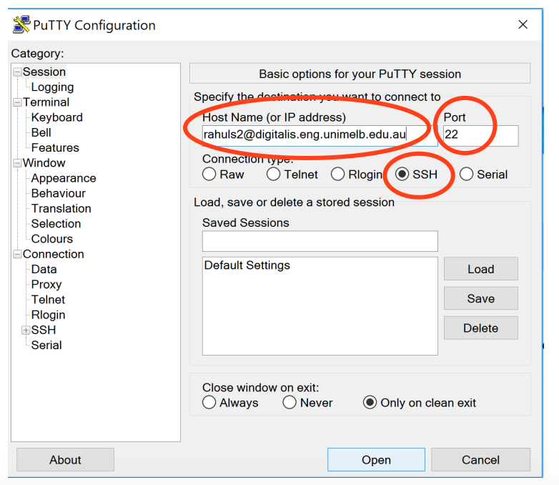

Slide 19
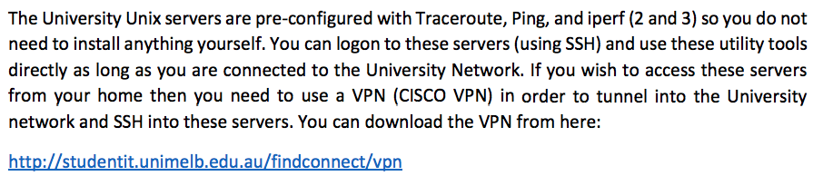
VPN

Slide 20
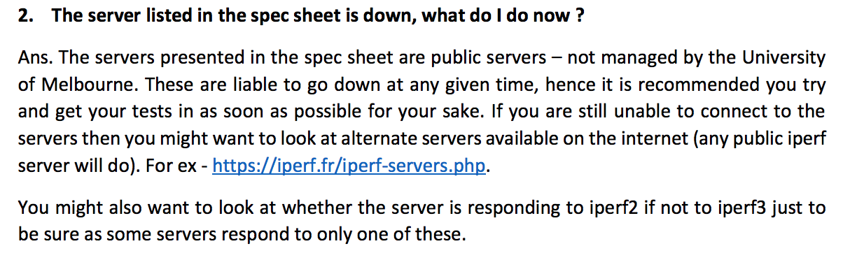
Tips：
server

Slide 21
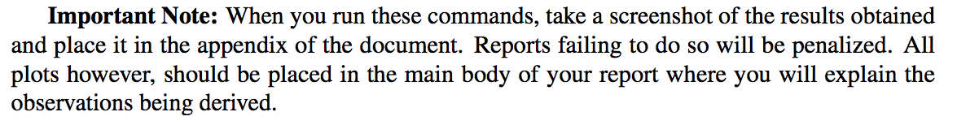
Tips：
Appendix

Slide 22
Tips：
Consistency
You should test all 8 servers either on ur own laptop, or digitalis, or VM.
Do not mix.
It is recommended that you perform these tasks in a consistent networking environment to reduce the variance in your results

Slide 23
Tips：
Order
traceroute --- hop number
ping --- delay and jitter
iperf --- bandwidth

